Slide 1
Basic methods for setting up models:
Differential Equations

Slide 2











Difference equation model of measles
$$λ_{t}$$
$$f$$
$$r$$
$$S_{t}$$
$$E_{t}$$
$$I_{t}$$
$$R_{t}$$
$$S_{t+1}=S_{t} −β ∗I_{t}∗S_{t}$$
$$E_{t+1}=E_{t}+β ∗I_{t}∗S_{t} −f ∗E_{t}$$
$$I_{t+1}=I_{t} + f ∗E_{t} −r ∗I_{t}$$
$$R_{t+1}=R_{t}+r ∗I_{t}$$
This enabled us to predict the evolution of the epidemic over time.

Slide 3
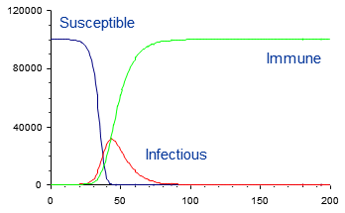
Difference equation model of measles
The reliability of models based on difference equations depends on the size of the time step used.

Slide 4
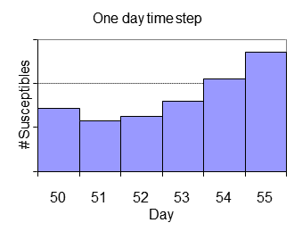
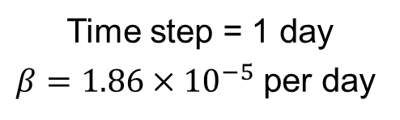
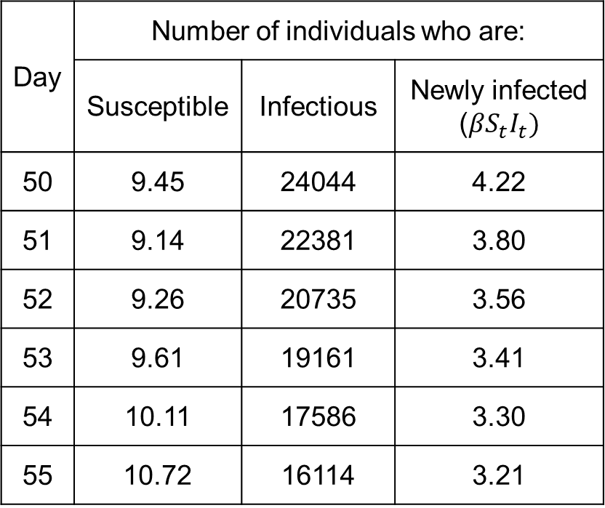
Model prediction using a oneday timestep
Day | Number of individuals who are:
 | Susceptible | Infectious | Newly infected ($βS_{t}I_{t})$
50 | 9.45 | 24044 | 4.22
51 | 9.14 | 22381 | 3.80
52 | 9.26 | 20735 | 3.56
53 | 9.61 | 19161 | 3.41
54 | 10.11 | 17586 | 3.30
55 | 10.72 | 16114 | 3.21
Time step = 1 day
$β=1.86×{10}^{−5}$ per day
the total number of newly infected individuals between 50 and 55 day was 18.29

Slide 5
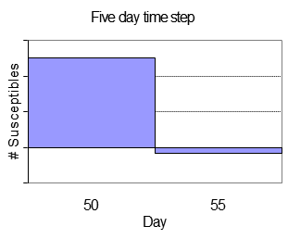
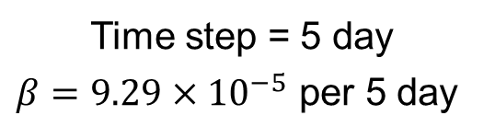
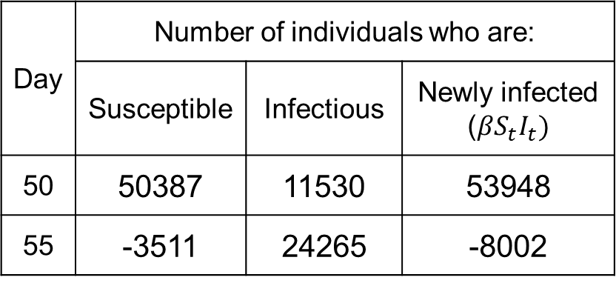
Model prediction using a fiveday timestep
Time step = 5 day
$$β=9.29×{10}^{−5} \text{per}\text{ 5 }\text{day}$$
Day | Number of individuals who are:
 | Susceptible | Infectious | Newly infected ($βS_{t}I_{t})$
50 | 50387 | 11530 | 53948
55 | -3511 | 24265 | -8002
the total number of newly infected individuals between 50 and 55 day was 53,948

Slide 6
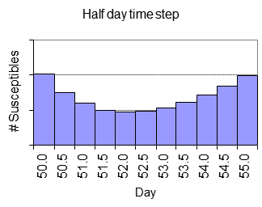
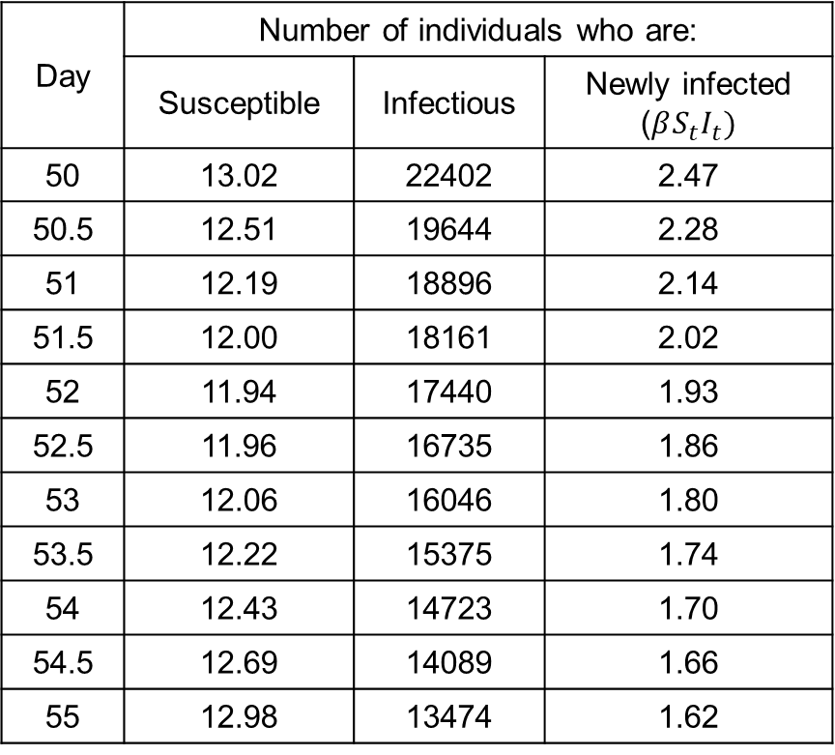
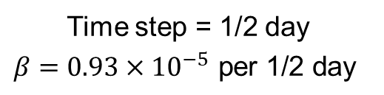
Model prediction using a halfday timestep
Day | Number of individuals who are:
 | Susceptible | Infectious | Newly infected ($βS_{t}I_{t})$
50 | 13.02 | 22402 | 2.47
50.5 | 12.51 | 19644 | 2.28
51 | 12.19 | 18896 | 2.14
51.5 | 12.00 | 18161 | 2.02
52 | 11.94 | 17440 | 1.93
52.5 | 11.96 | 16735 | 1.86
53 | 12.06 | 16046 | 1.80
53.5 | 12.22 | 15375 | 1.74
54 | 12.43 | 14723 | 1.70
54.5 | 12.69 | 14089 | 1.66
55 | 12.98 | 13474 | 1.62
Time step = 1/2 day
$$β=0.93×{10}^{−5} \text{per}\text{ 1/2 }\text{day}$$
the total number of newly infected individuals between 50 and 55 day was 21.22

Slide 7
Difference vs differential equations
The highest precision is obtained when we use time steps that are as small as possible
We update our model continuously, rather at set intervals using differential equations
Differential equations are very similar to the difference equations
Difference equations described the total number of individuals in each category at time t
Differential equations describe the rate of change of the number of individuals in each category at time t
In difference equations we should use risks, and in differential equations we should use rates. However, risks and rates are numerically similar if they are small (<10%).

Slide 8
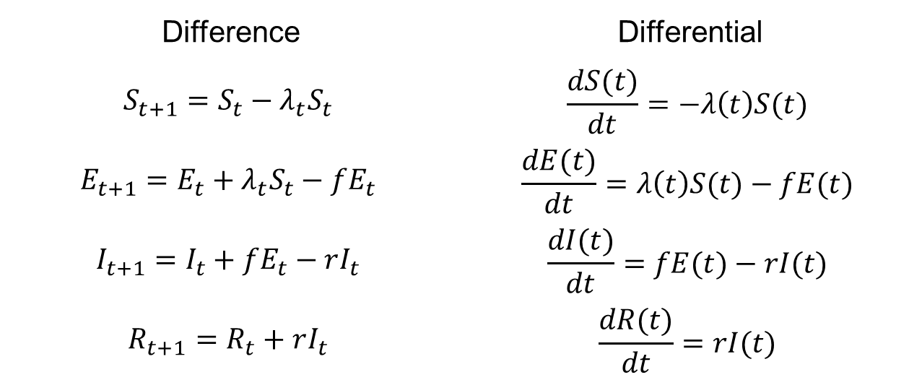
Difference vs differential equation
The number of susceptibles at time t (assumed constant between t and t+1)
The rate of change in the number of susceptibles at time t
Difference | Differential
$$S_{t+1}=S_{t}−λ_{t}S_{t}$$ | $$\frac{dS(t)}{dt}=−λ\left(t\right)S(t)$$
$$E_{t+1}=E_{t}+λ_{t}S_{t}−fE_{t}$$ | $$\frac{dE(t)}{dt}=λ\left(t\right)S(t)−fE(t)$$
$$I_{t+1}=I_{t}+fE_{t}−rI_{t}$$ | $$\frac{dI(t)}{dt}=fE(t)−rI(t)$$
$$R_{t+1}=R_{t}+rI_{t}$$ | $$\frac{dR(t)}{dt}=rI(t)$$
The risk of susceptibles becoming pre-infectious between t and t+1
The rate at which susceptibles become pre-infectious per unit time, at time t

Slide 9








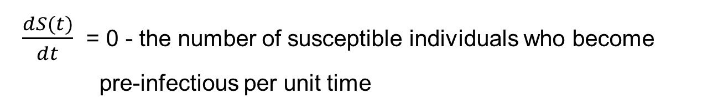
The rate of change in the number of susceptible individuals over time
$$λ(t)$$
$$f$$
$$r$$
$$S(t)$$
$$E(t)$$
$$I(t)$$
$$R(t)$$
Rate of change in the number of individuals in a category over time
= the number who enter the category per unit time
- the number who exit the category per unit time
$\frac{dS(t)}{dt}$ = 0 - the number of susceptible individuals who become
pre-infectious per unit time
= -$λ\left(t\right)S\left(t\right)$

Slide 10








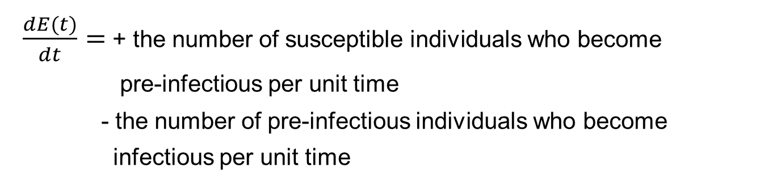
The rate of change in the number of
Pre-infectious individuals over time
$$λ(t)$$
$$f$$
$$r$$
$$S(t)$$
$$E(t)$$
$$I(t)$$
$$R(t)$$
$\frac{dE(t)}{dt}=$ + the number of susceptible individuals who become
pre-infectious per unit time
- the number of pre-infectious individuals who become
infectious per unit time
$= λ\left(t\right)S\left(t\right)$ - $fE\left(t\right)$

Slide 11







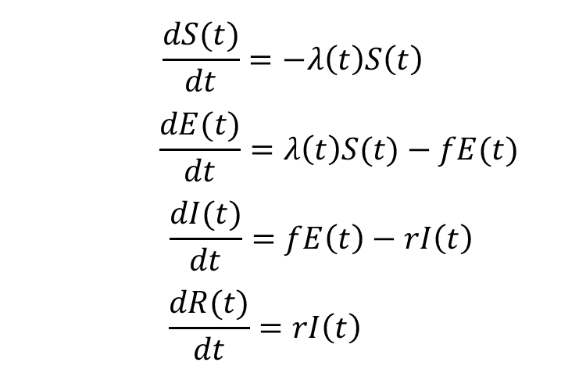
Differential equations for measles model
$$λ(t)$$
$$f$$
$$r$$
$$S(t)$$
$$E(t)$$
$$I(t)$$
$$R(t)$$
$$\frac{dS(t)}{dt}=−λ\left(t\right)S\left(t\right)$$
$$\frac{dE(t)}{dt}=λ\left(t\right)S(t)−fE(t)$$
$$\frac{dI(t)}{dt}=fE\left(t\right)−rI\left(t\right)$$
$$\frac{dR(t)}{dt}=rI\left(t\right)$$

Slide 12






Hookworm
$$λ(t)$$
Susceptible
Infected
$$r_{2}$$
Recovered
$$S(t)$$
$$I(t)$$
$$R(t)$$
$$r_{1}$$

Slide 13









Haemophilus Influenza type B (HiB)
Diseased
$$D(t)$$
$$r_{3}$$
$$f$$
$$λ(t)$$
Carrier
Recovered
Susceptible
$$C(t)$$
$$r_{2}$$
$$R(t)$$
$$S(t)$$
$$r_{1}$$

Slide 14
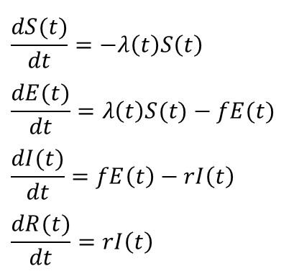
Solving differential equations
$$\frac{dS(t)}{dt}=−λ\left(t\right)S\left(t\right)$$
$$\frac{dE(t)}{dt}=λ\left(t\right)S(t)−fE(t)$$
$$\frac{dI(t)}{dt}=fE\left(t\right)−rI\left(t\right)$$
$$\frac{dR(t)}{dt}=rI\left(t\right)$$
We want to predict the number of susceptibles (etc) at time t, given a set of differential equations which describe the rate of change over time.
As for difference equations, we need to solve these equations.
There are only a few, simple cases where we can write down the solution to these equations, called solving the equations analytically.
For the rest we solve them numerically, which converts the differential equations back into difference equations (e.g. Euler, Runge-Kutta), but monitors errors in a tolerance and/or adjusts the results to correct the errors.

Slide 15







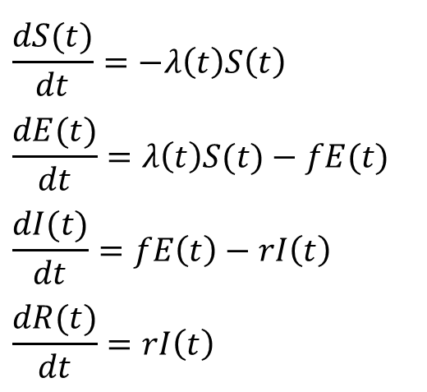
Remember
$$λ(t)$$
$$f$$
$$r$$
$$S(t)$$
$$E(t)$$
$$I(t)$$
$$R(t)$$
$$\frac{dS(t)}{dt}=−λ\left(t\right)S\left(t\right)$$
$$\frac{dE(t)}{dt}=λ\left(t\right)S(t)−fE(t)$$
$$\frac{dI(t)}{dt}=fE\left(t\right)−rI\left(t\right)$$
$$\frac{dR(t)}{dt}=rI\left(t\right)$$

Slide 16
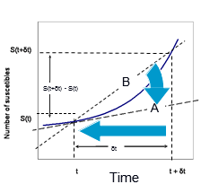
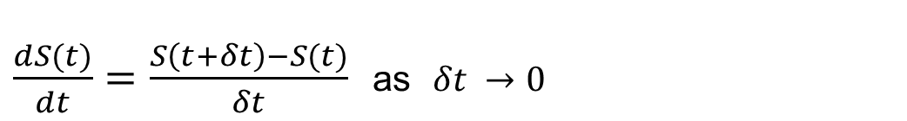
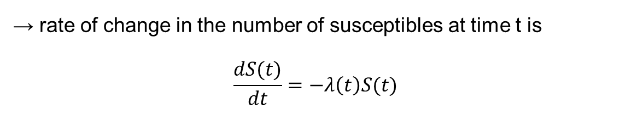
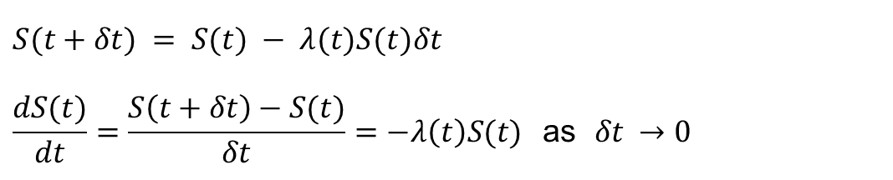
A1: Derivation of differential equations
$\frac{dS(t)}{dt}=\frac{S\left(t+δt\right)−S(t)}{δt}$ as $δt →0$
$$S(t+δt) = S(t) − λ(t)S(t)δt$$
$$\frac{dS(t)}{dt}=\frac{S\left(t+δt\right)−S(t)}{δt}=−λ\left(t\right)S(t\text{) }\text{as} δt →0$$
→ rate of change in the number of susceptibles at time t is
$$\frac{dS(t)}{dt}=−λ\left(t\right)S(t)$$

